Slide 1
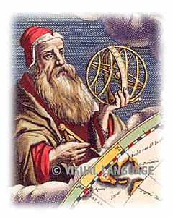
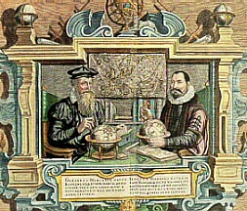
LARGER NEW WORLDS are DISCOVERED……
Take a look… notice what’s missing? See the shadow outline of the Americas? Didn’t know they existed
Pre-Columbus Mercator and Hondius Map of the World

Slide 2
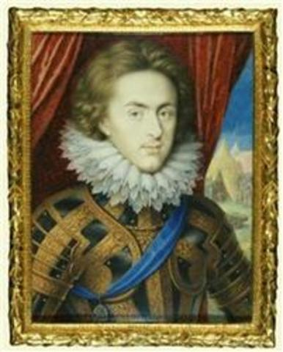
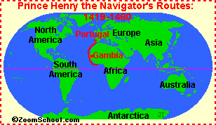
Early to mid 1400s:
Prince Henry “The Navigator” of Portugal led the way and opened the door to exploration.
He paid for explorations
He set up a school of navigation
He Gathered scientists & Cartographers = a person who draws or produces maps
The earliest explorations were around the coast of West Africa,
Most of the new technology and maps came from the east and the Arab World

Slide 3
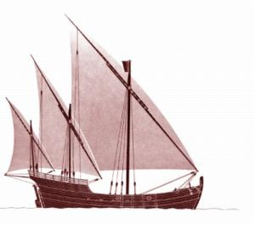
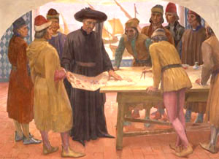
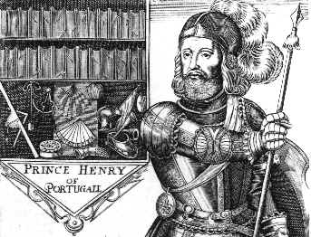
The caravel of the 15th century was a type vessel with lateen sails (triangular sails supported by a beam at the top), extremely maneuverable.
The design was such a success that Prince Henry the Navigator used it to design his ships of exploration.

Slide 4
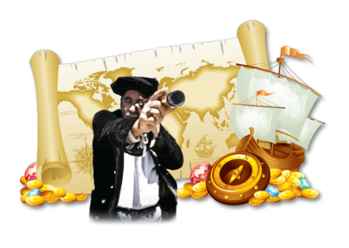
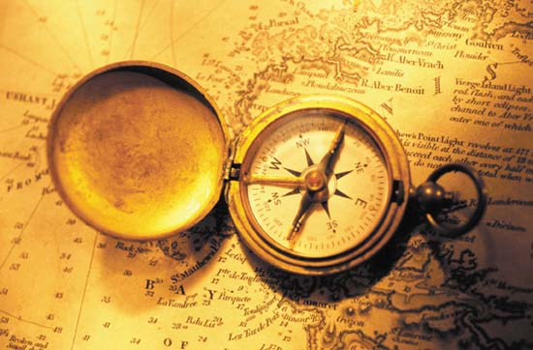
The Magnetic Compass - is an instrument that uses a magnetized steel bar to indicate direction relative to the earth's magnetic poles.
It has been used for navigation for hundreds of years; invented by the Chinese.

Slide 5
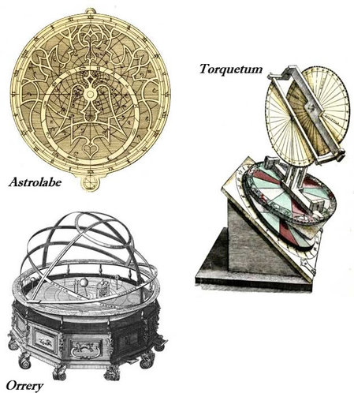
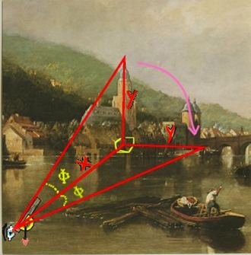
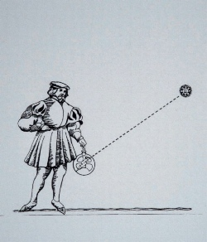
Astrolabe
Uses coordinates via the sky:
It allowed sailors to approximate the time and direction in which they were sailing, and the number of days passed
The astrolabe can also be used to estimate the height of a building or a tree

Slide 6
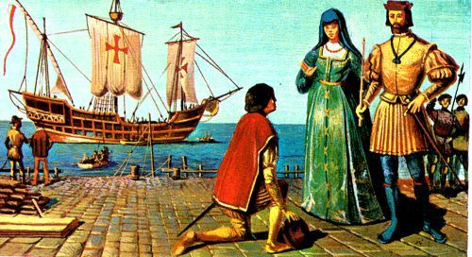
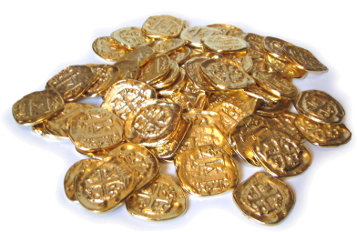
In 1492:
Ferdinand and Isabella, the King and Queen of Spain, expel all Jews from their country after successfully driving out the Muslims through warfare... Remember, the Spanish Reconquista? Their plan of “reconquering Spain for God and the Catholic Church.”
NOW – they have time & $$$ to explore!!!!
Spain then put all its effort into……. finding a route to the East Indies
Purpose: Spices, wealth, spread of Christianity
Christopher Columbus is sent off to find the East Indies, funded by Spain

Slide 7
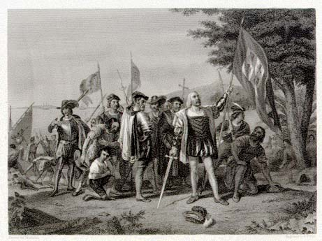
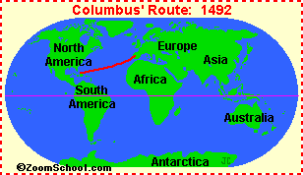
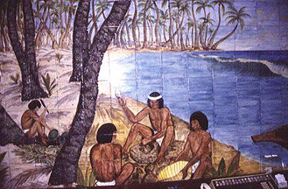
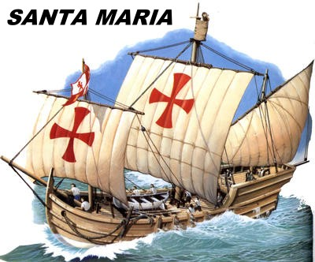
Two Worlds Meet in 1492
Columbus lands in San Salvador, in the Caribbean
Sadly - Within 16 years of Columbus’ arrival all the Taino Natives were dead of disease and mistreatment & they lost their land to the Spanish.
San Salvador
Taino Native Americans

Slide 8
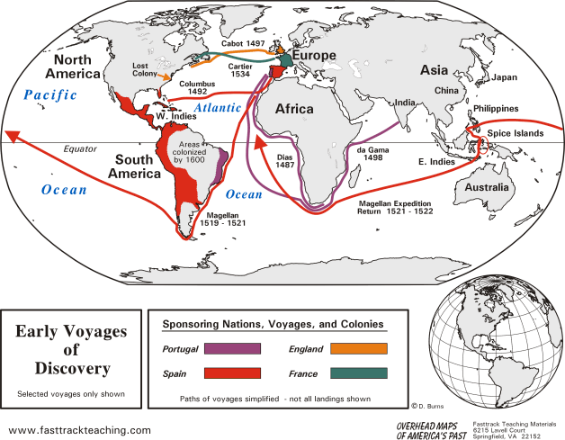

Slide 9
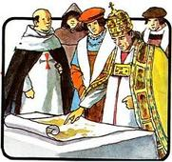
In 1493 the Pope drew the: LINE of DEMARCATION to divide the “New World” between Spain and Portugal.
Anything to the West of a vertical line through South America could be claimed by Spain
Anything to the east of the vertical line went to Portugal (Brazil)

Slide 10
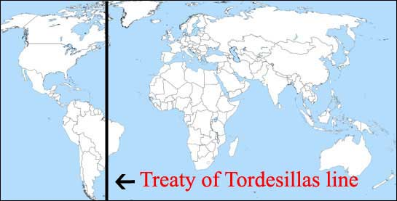
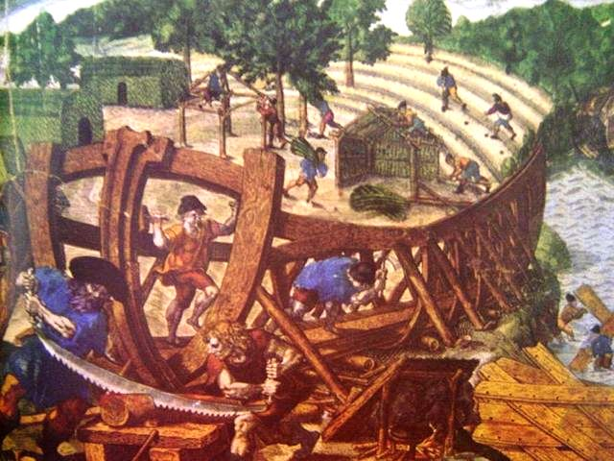
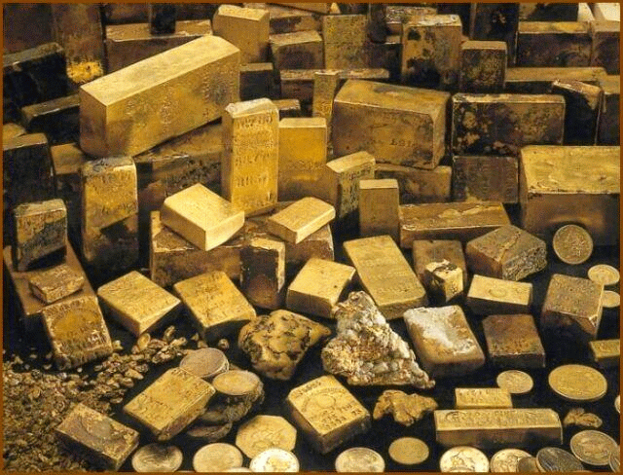
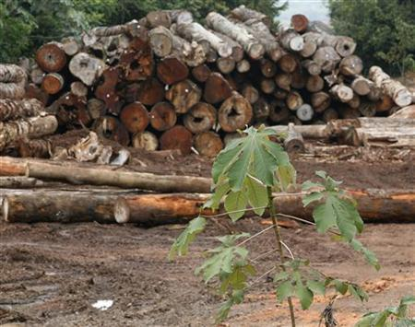
In 1494 Spain and Portugal signed THE TREATY OF TORDESILLAS dividing the “New World” between them;
This resulted in incredible gains in wealth by Spain
They now controlled the gold-laden continent of South America
And the resource-rich Amazon River Basin.

Slide 11
Bartolomeu Dias Portugal | 1488 | Discovered the overseas route to the Indian Ocean | Sailed around the Cape of Good Hope at southern tip of Africa
Vasco da Gama Portugal | 1497 or 1498 | The first European to reach India through an overseas route | Landed in India in 1498. Allowed goods transported more cheaply
Christopher Columbus Spain | 1492 | “Discovered” San Salvador (the Americas) | New World opened for trade, colonies, & settlement
Amerigo Vespucci Italy | 1497 - 1507 | First to use the term “New World” - made several trips there | Did not think land he saw was Asia, German mapmaker named “America” after him
Vasco Nunez de Balboa Spain | 1513 or 1519 | Crossed Panama and saw the Pacific Ocean | Established the fact that N. America was not part of Asia.
Ferdinand Magellan Spain | 1519 or 1520 | 1st to circumnavigate the world - go all the way around it | Passed through straits at S. tip of So.Am.-reached Pacific-prove Earth round

Slide 12
Use this slide (12) and slides 13 – 24 to complete the graphic organizer.

Slide 13
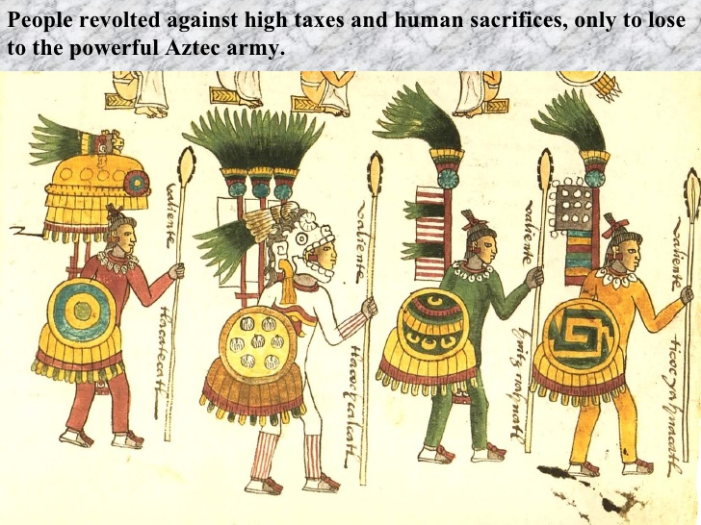
The Conquistadors
Hernan Cortes (also spelled Cortez) conquered Mexican Empire (Aztecs), 1519-21
Led revolt by using subject tribes who resented tribute & human sacrifices
Hernan Cortes
The Spaniards did not like the Aztec religion & forced them to convert to Christianity

Slide 14
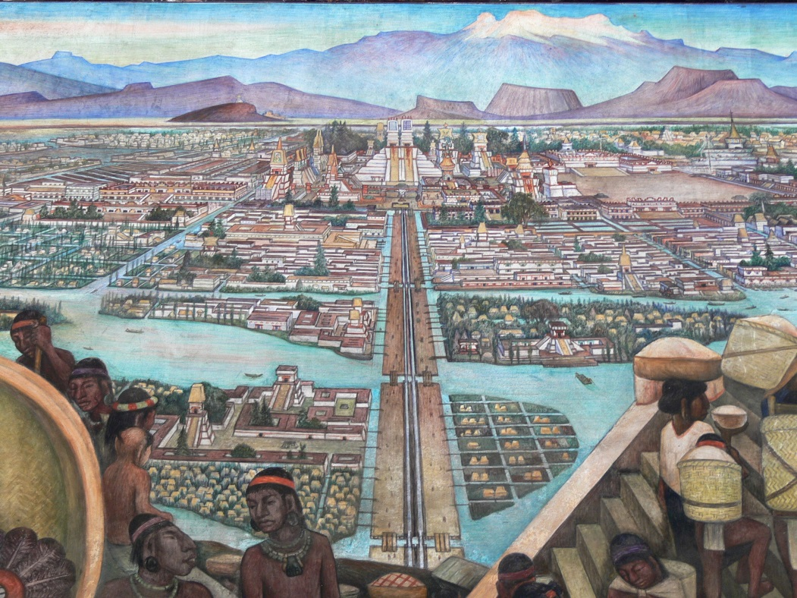
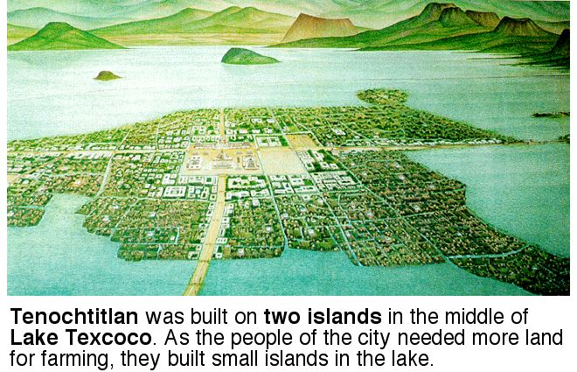
The Aztec city of Tenochtitlan (their capital)
This information is to help you complete the graphic organizer. PLUS - it’s interesting!
Through the Aztecs’ efforts, Tenoch-titlán became the greatest city in the Americas. It had huge temples, a busy market, clean streets, and a magnificent palace. The first Europeans in the city were stunned by what they saw. It was one of the world’s largest cities. “These great towns and pyramids and buildings rising from the water, all made of stone, seemed like an enchanted vision . . . It was all so wonderful that I do not know how to describe this first glimpse of things never heard of, seen, or dreamed of before.” –Bernal Díaz del Castillo, from The Conquest of New Spain

Slide 15
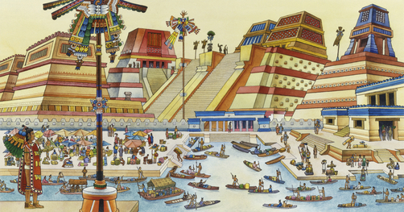
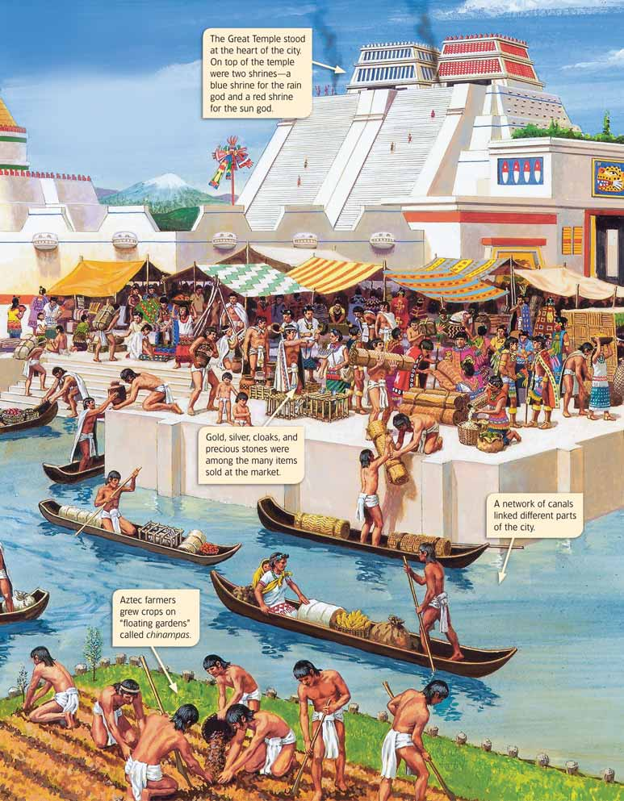
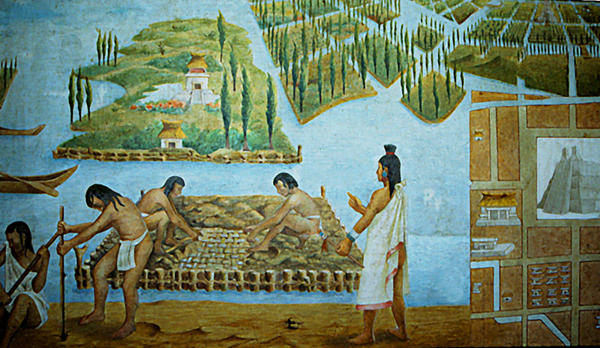
"
The Aztec city of Tenochtitlan was surrounded by Chinampas – small, floating, man-made gardens created by interweaving reeds.

Slide 16
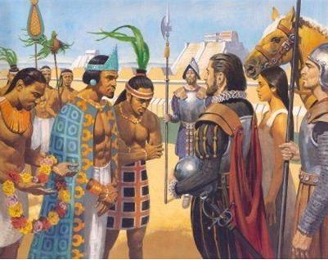
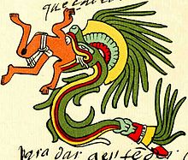
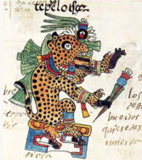
Spaniards vs. Aztecs
Aztec leader – Moctezuma (also spelled Montezuma)
Moctezuma and the Aztecs thought that Cortés & his men were Quetzalcoatl and other of the Aztec gods returning to live among them.
The Aztecs had never seen white people or anyone with facial hair. They had never seen horses either. They thought the man and horse was all one creature.
Moctezuma meets Cortés with Malinche, a native woman from another tribe, as an interpreter

Slide 17
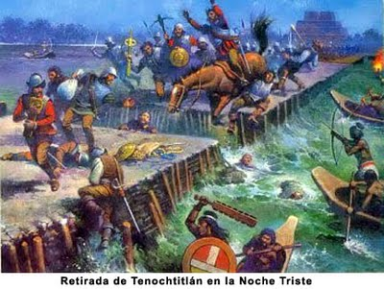
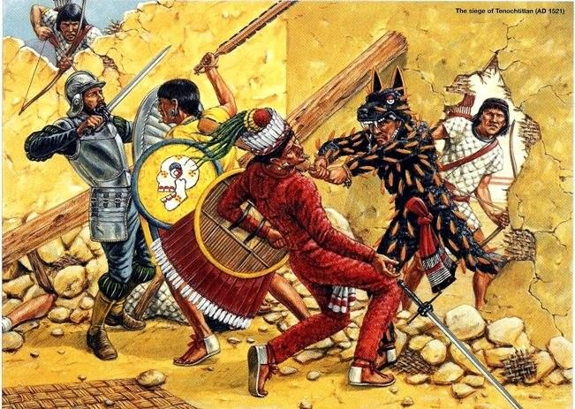
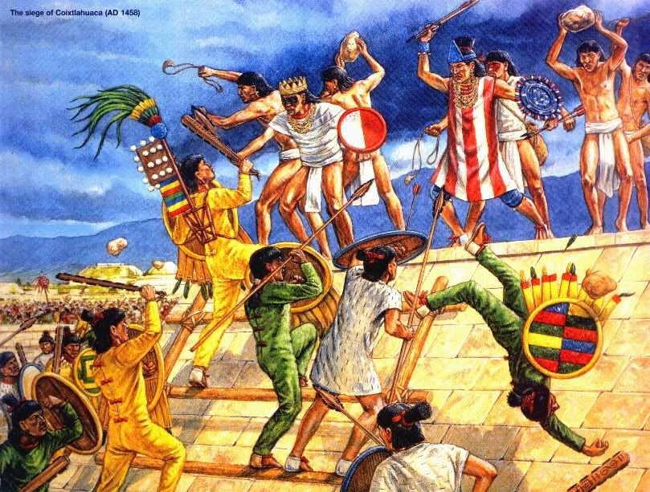
Spaniards vs. Aztecs
The Aztecs grew tired of the Spaniards taking all of their gold and mistreating them. They drove the Spaniards from the city of Tenochtitlan.
Moctezuma was killed during the battle

Slide 18
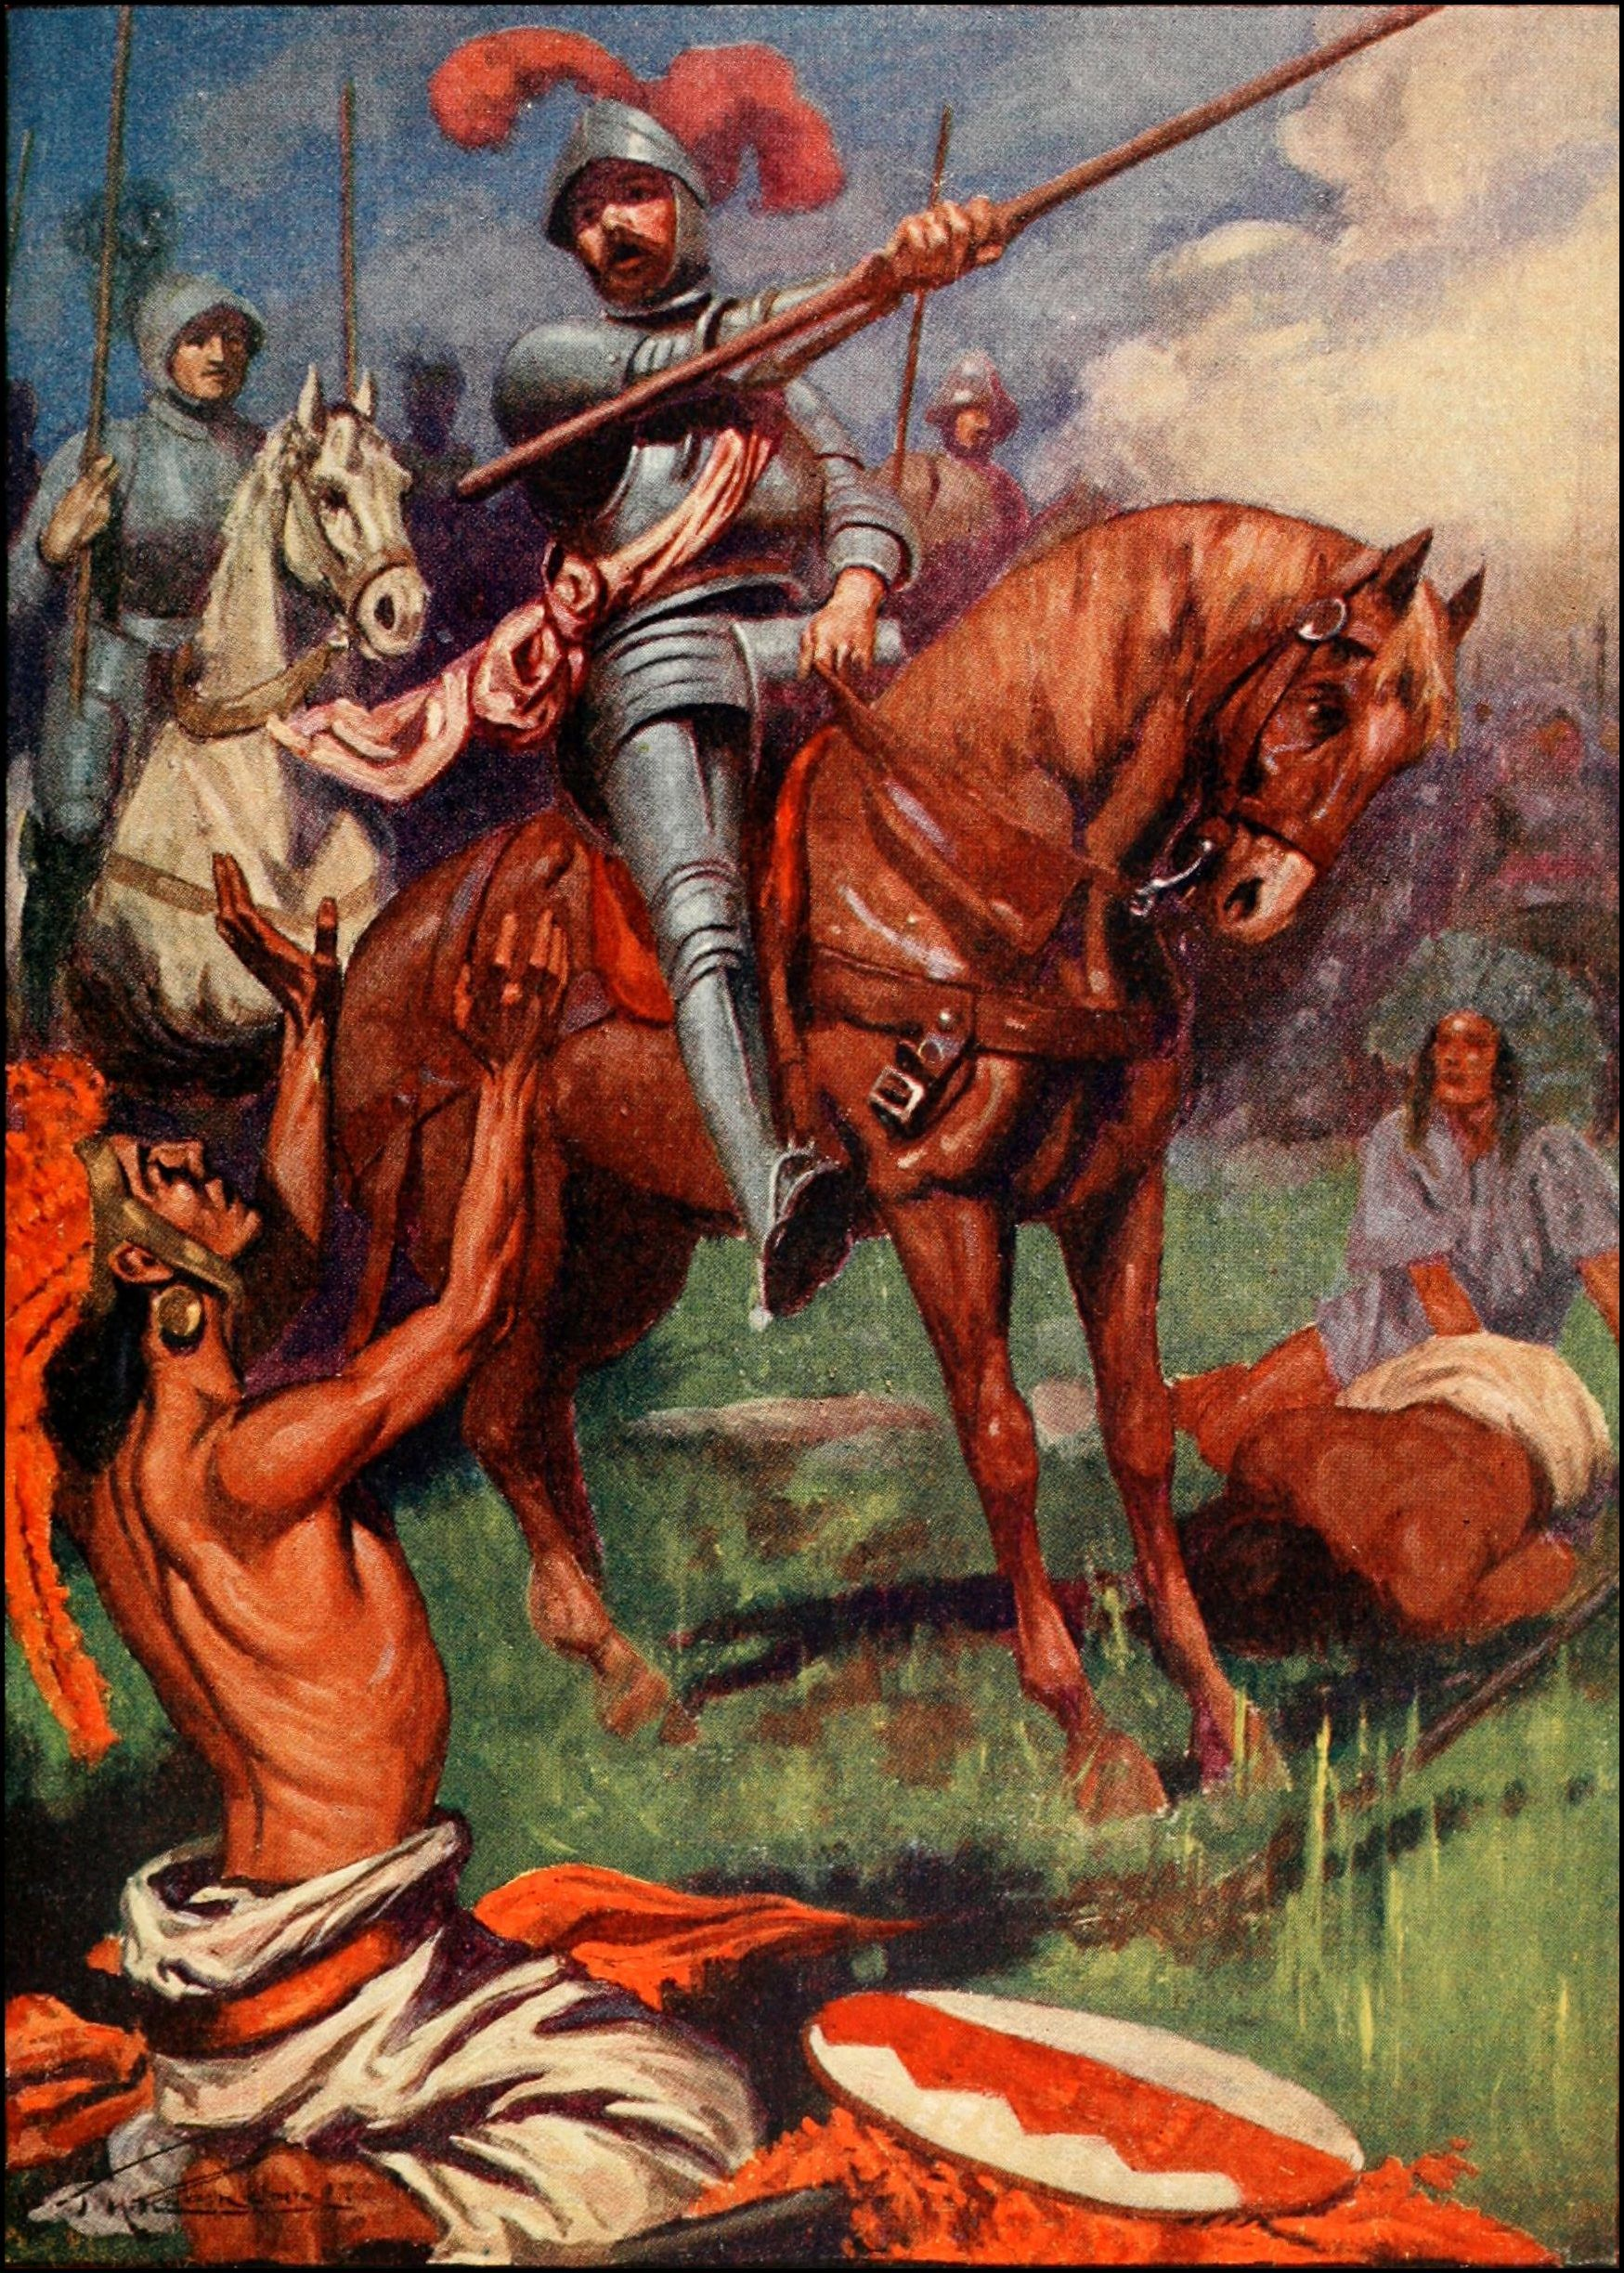
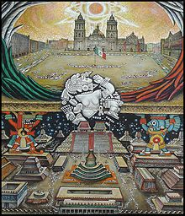
Spaniards vs. Aztecs
Cortes counter attacks and takes the city of Tenochtitlan. Spain then builds their city, now known as Mexico City.

Slide 19
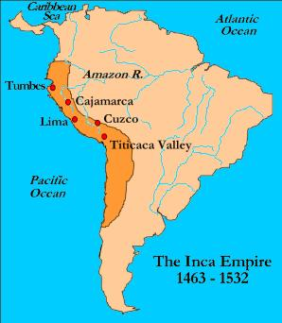
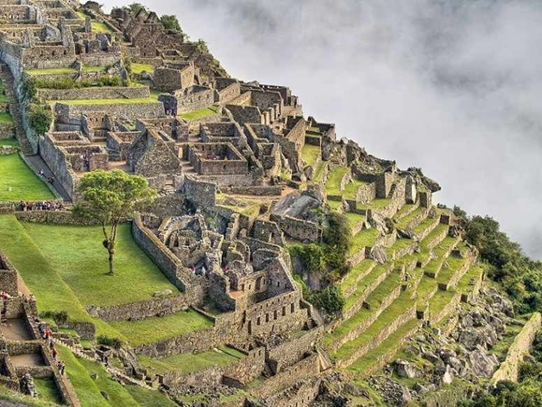
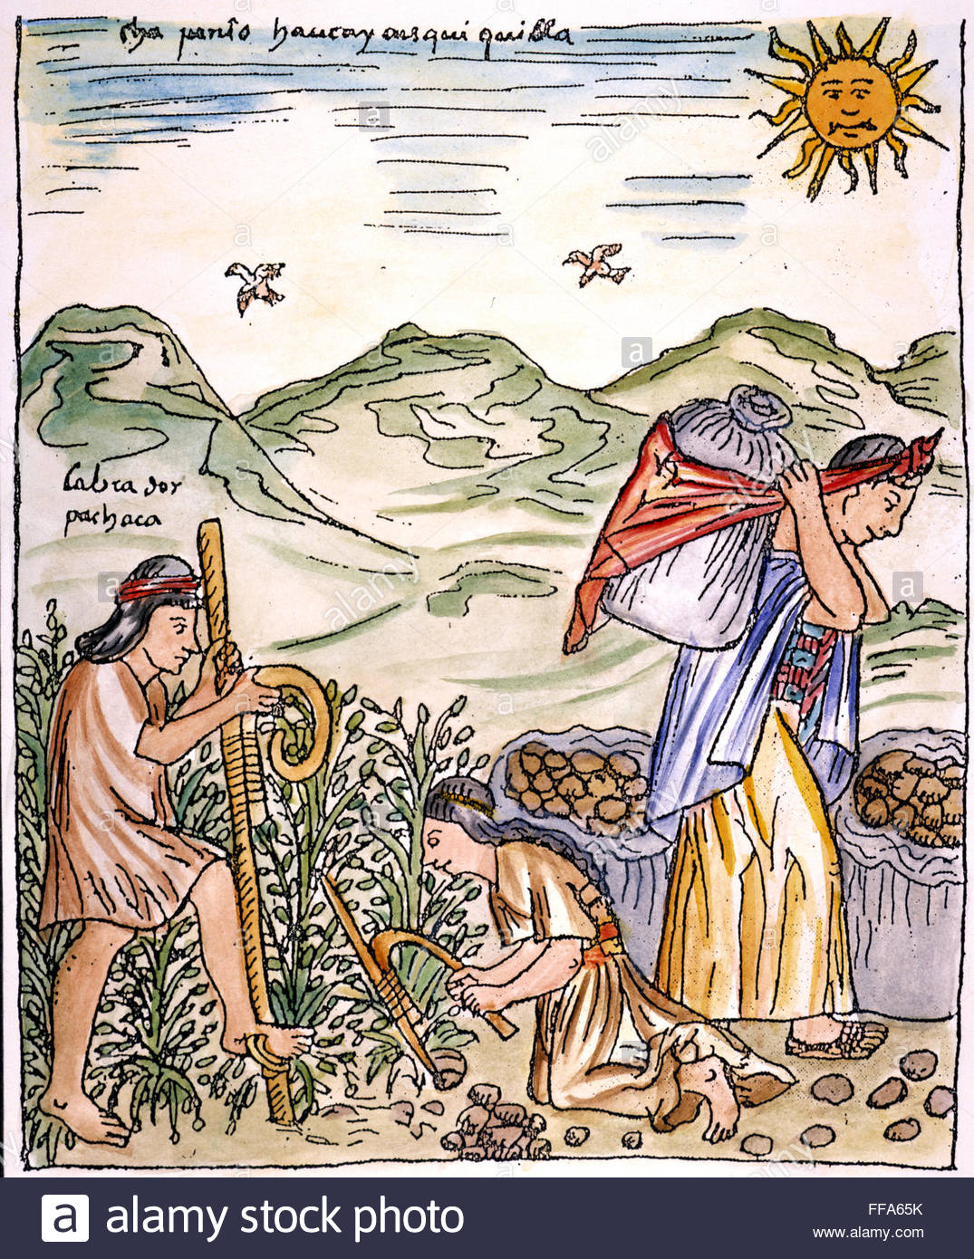
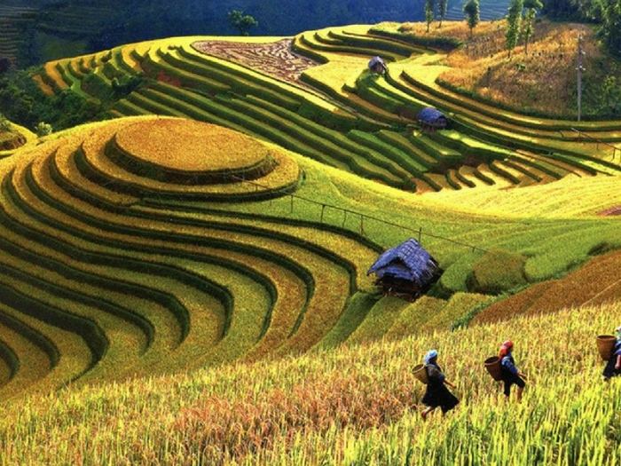
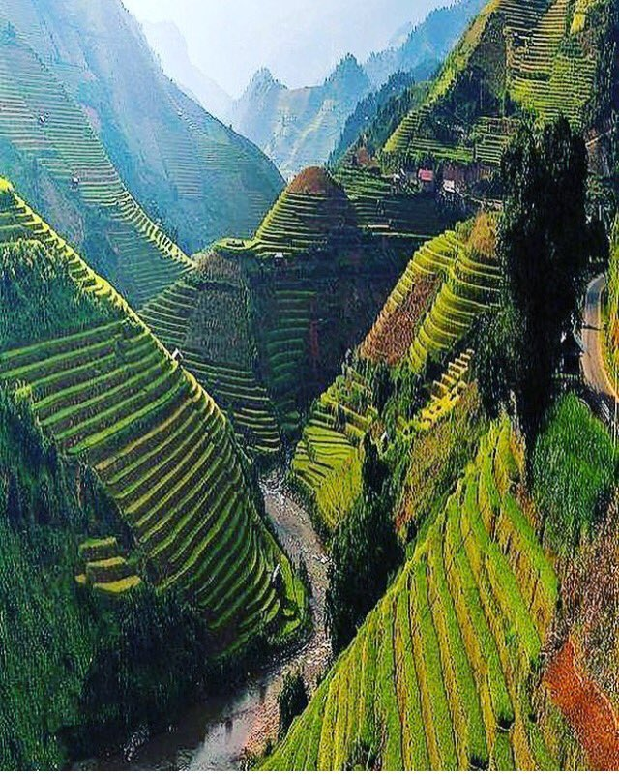
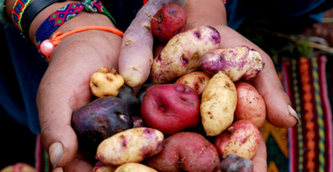
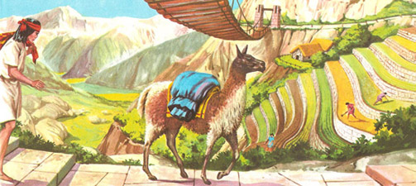
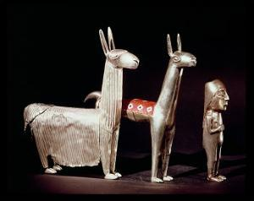
The Inca Empire 1463-1532
The Inca were the first to cultivate potatoes

Slide 20
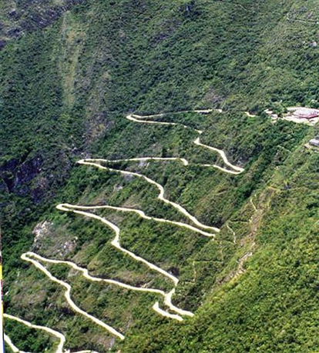
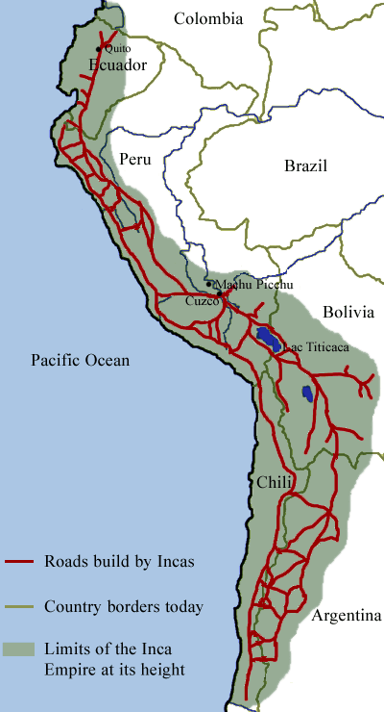
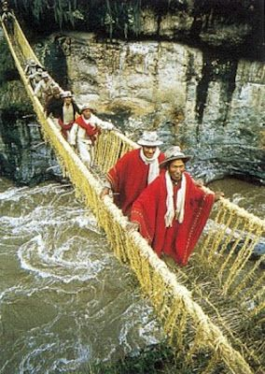
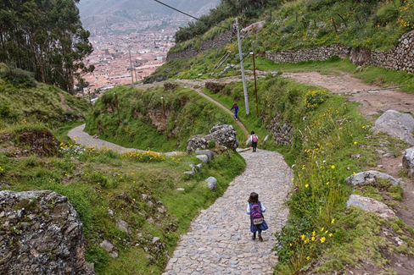

Slide 22
The Conquistadors
Francisco Pizzaro
Took advantage of Inca civil war between rival brothers
The Spanish Conquered Incan Empire, 1531-32
With fewer than 200 men against several thousand, Pizarro lures the Incan Emperor Atahualpa to a feast in the emperor's honor and then opens fire on the unarmed Incans.
Pizarro Executes Atahualpa, the 13th and last emperor of the Incas, who dies by strangulation.

Slide 23
The Incas had no immunity against European diseases, and it is estimated that as many as 250,000 Incas may have died of smallpox before any of them even saw a European. European Diseases killed an estimated 90% of all Native Americans
The Spaniards purposely gave the Inca blankets contaminated with smallpox
Spread smallpox deliberately
Biological Warfare

Slide 24
Reasons for Spanish Victory
Superior military technology – steel swords, guns, cannons, armor, horses, etc.
Division of South and North American tribes – created dissention and civil wars
Disease – horrific smallpox, measles, mumps, influenza, pertussis, diptheria, and many more
Many Native Americans believed it was the end of the world – and for many of them – it was ☹

Slide 25
The ENCOMIENDA SYSTEM was the forced labor of Native Americans in Latin America by the Spanish
Bartolome de Las Casas
Catholic Priest
Wrote to the King of Spain to protest the abuse of Native Americans & he wanted to help them.
But…. He proposed that they bring over Africans as slaves instead!

Slide 26
Spanish Colonies in the Americas
1542- The Laws of the Indies – forbade enslavement & abuse of Native Americans
Alternative – bring slaves from Africa (just as de las Casa had suggested!)
Workers from Africa were brought to the Americas
They were immune to tropical diseases and were skilled workers

Slide 27
Spain and Portugal were getting very wealthy from their colonies!!!!
Much of Portugal’s wealth came from the slave trade and the exporting of spices and other goods from the East.
Because of all the gold, silver and other minerals coming out of Mexico and South America the Spanish became one of the wealthiest and most powerful countries in Europe.
How do you think the Dutch, French and English felt about Portugal and Spain’s colonies and wealth? Probably not so great!!!!! They were very jealous. They wanted their fair share!!! Great rivalries for power, wealth and colonies developed all over Europe and the New World.

Slide 28
Struggles in North America
The French
New France (Canada)
Wanted to spread Christianity
Trade Fur
Accepted and adapted to Native American way of life

Slide 30
Struggles in North America
The English
Jamestown 1607 – First successful English colony
Exported tobacco
1620 - Pilgrims in Massachusetts , Pennsylvania & Maryland sought religious freedom

Slide 31
Struggles in North America
13 colonies develop
Needed workers to work the land
Brought slaves from Africa

Slide 32
Struggles in North America
British/French Rivalry
Clashed in Europe and in North America
French and Indian War
Also known as the Seven Years’ War
British win – sign Treaty of Paris – ensures British dominance in North America

Slide 33
Triangular Slave Trade
Spanish & Portuguese controlled the slave trade in the 1500s
Triangular Trade
1st leg - Europe to Africa – goods (guns, cloth, cash)
2nd leg - Africa to Americas – brought Slaves also known as the Middle Passage
3rd leg - North America & the Americas to Europe – Tobacco, sugar, molasses, cotton, furs, salt fish, rum

Slide 34
Triangular Trade Routes

Slide 35
The MIDDLE PASSAGE - the horrific human journey - the “middle leg” of the triangular trade – slaves were transported from Africa to the Americas

Slide 37
10 to 16 million Africans were transported across the Atlantic to the America between 1500 and 1900
at least 2 million Africans-died during the Middle Passage
for every 100 slaves who reached the New World, 40 died in Africa or during the Middle Passage

Slide 38
in ships, slaves live in spaces less then 5 feet high
horrific odors filled those spaces
the most serious danger was dehydration
many Africans attempted suicide
there was a revolt on one in every ten voyages
the Middle Passage between Africa and America usually took more than seven weeks

Slide 39
Triangular Slave Trade
Impact of the slave trade
80,000 slaves were shipped to the Americas per year by the 1780s
Some African tribes were so depleted they ceased to exist!
Other nations in Africa depended on the slave trade
They fought wars with each other in order to capture slaves to sell to the Europeans.

Slide 40
Columbian Exchange: Movement of goods & people between Europe, Africa & Americas following Christopher Columbus’s discovery in the “New World”

Slide 41
 | Old World to New World | New World to Old World
Diseases | Smallpox, Measles, Chicken Pox Malaria, Yellow Fever, Influenza, The Common Cold | Syphilis
Animals | Horses, Cattle, Pigs, Sheep Goats, Chickens | Turkeys, Llamas, Alpacas, Guinea Pigs
Plants | Rice Wheat Barley Oats Coffee Sugarcane Bananas Melons Olives Dandelions Daisies Clover Ragweed Kentucky Bluegrass | Corn (Maize) Potatoes (White & Sweet Varieties) Beans (Snap, Kidney, & Lima Varieties) Tobacco Peanuts Squash Peppers Tomatoes Pumpkins Pineapples Cacao (Source of Chocolate) Chicle (Source of Chewing Gum) Papayas Guavas Avocados

Slide 42
New foods led to population growth
_______________________________
Mercantilism:
A successful nation must export more goods than they import
Colonies will be important because they provide natural resources & markets
__________________________________
CHANGES IN EUROPE:
Europe’s wealth grows
European countries became jealous of each others’ wealth
Colonies become angry with Europe because they were not represented; to many restrictions, too many taxes, etc.

